Slide 1
Unified mentor Front-End Development Internship :
Tic-Tac-Toe
My Portfolio
Weather App
To-Do App
Basic Calculator
Recipe Book
Music Player
Interactive Resume
Info
Graphics
Virtual Pet Simu
Thispresentationshowcaseswebdevelopmentproject:Interactive Quiz .ThisprojectutilizeHTML,CSS, andJavaScript,demonstratingmycodingskillsandprojectdevelopment experience.Thisprojecthighlightmyabilitytocreateinteractiveandengaging webapplications,showcasingmypassionforwebdevelopmentandcommitment tobuildinghigh-quality, user-friendlywebsite.
A Web Development Showcase
Memory Card Game
Interactive Quiz
Countdown Timer
Blog Website
Virtual Art gallery
byMandadiRohitReddy
InternshipID:UMIP278665
M R
Chat Application
Interactive Story telling
Interactive Map
Image Slider
Expense Tracker

Slide 2
Interactive Quiz in HTML,CSS and JS

Slide 3
Introduction
The Interactive Quiz is a web-based application developed using HTML, CSS, and JavaScript. It provides users with a fun and engaging way to test their knowledge on various topics through multiple-choice questions. The project demonstrates core concepts of web development such as dynamic content rendering, event handling, timer functionality, and responsive design.
The quiz includes a series of questions, each with four possible answers. Users receive immediate feedback after selecting an option, and their score is calculated in real-time. The quiz also features a countdown timer to add a sense of urgency and excitement. At the end of the quiz, users can view their total score and restart the quiz to try again.
This project is an excellent example of how front-end technologies can be combined to build an interactive and user-friendly application.

Slide 4
✅ Key Features & Concepts:
DOM Manipulation: Dynamically updating questions, answers, and feedback based on user interaction.
Event Handling: Handling button clicks and timer events.
Arrays and Objects: Storing and accessing question data using JavaScript objects in an array.
Conditionals and Loops: Logic for evaluating answers and progressing through the quiz.
Responsive Design: Ensures the quiz layout works well on various screen sizes.
Timer Integration: Implements countdown functionality to create urgency.

Slide 5
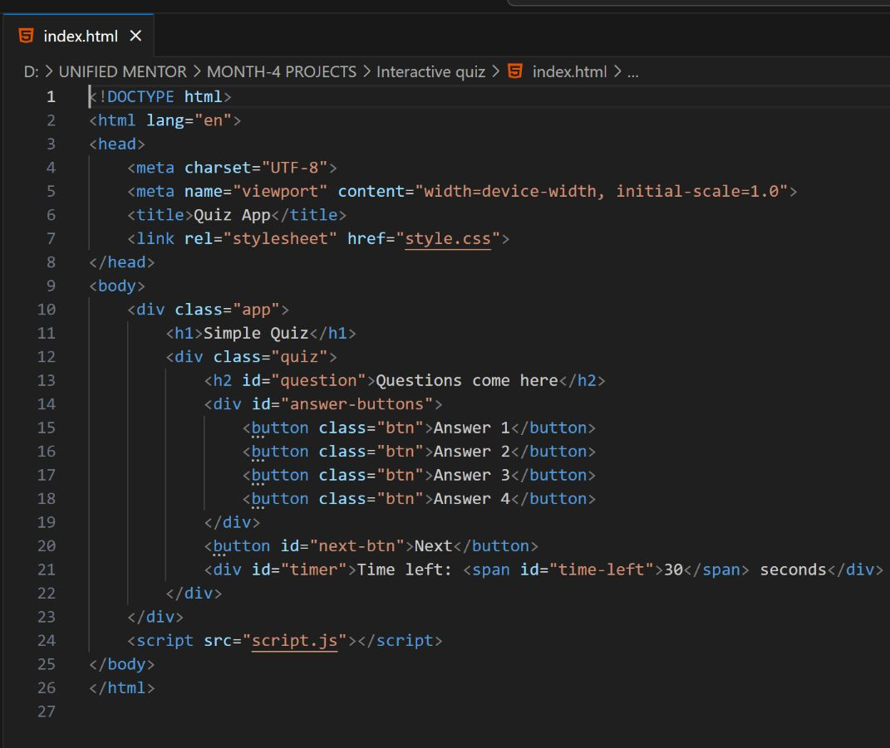
✅ Technologies Used: HTML
HTML (HyperText Markup Language):Used for structuring the content and layout of the quiz interface including questions, buttons, and containers.

Slide 6
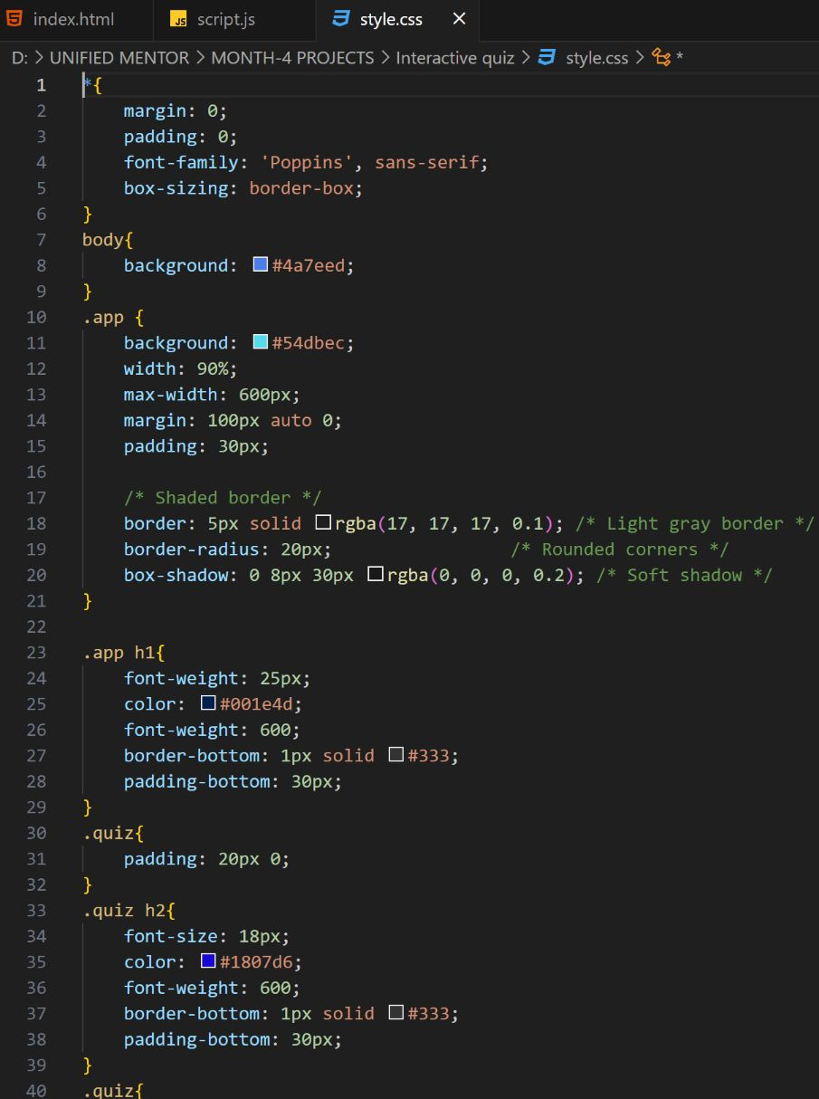
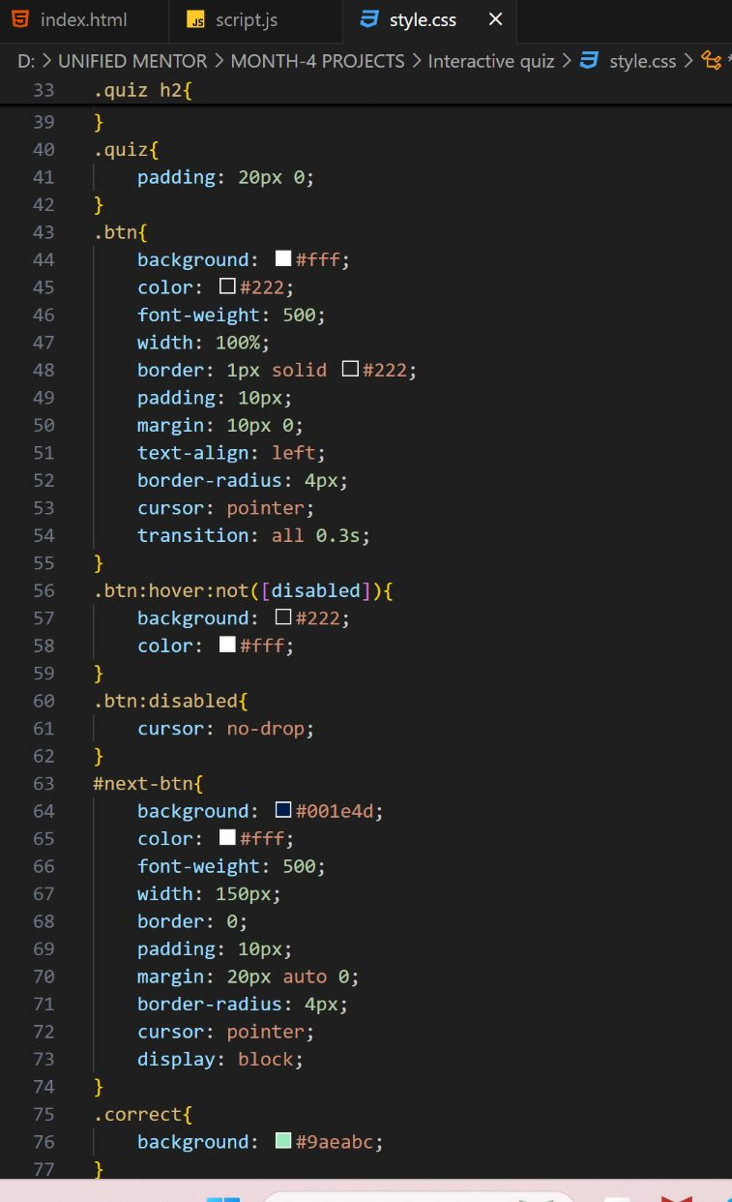
CSS:
CSS (Cascading Style Sheets):Used for designing and styling the layout, buttons, and elements to enhance user experience with colors, spacing, borders, shadows, and responsiveness.

Slide 7
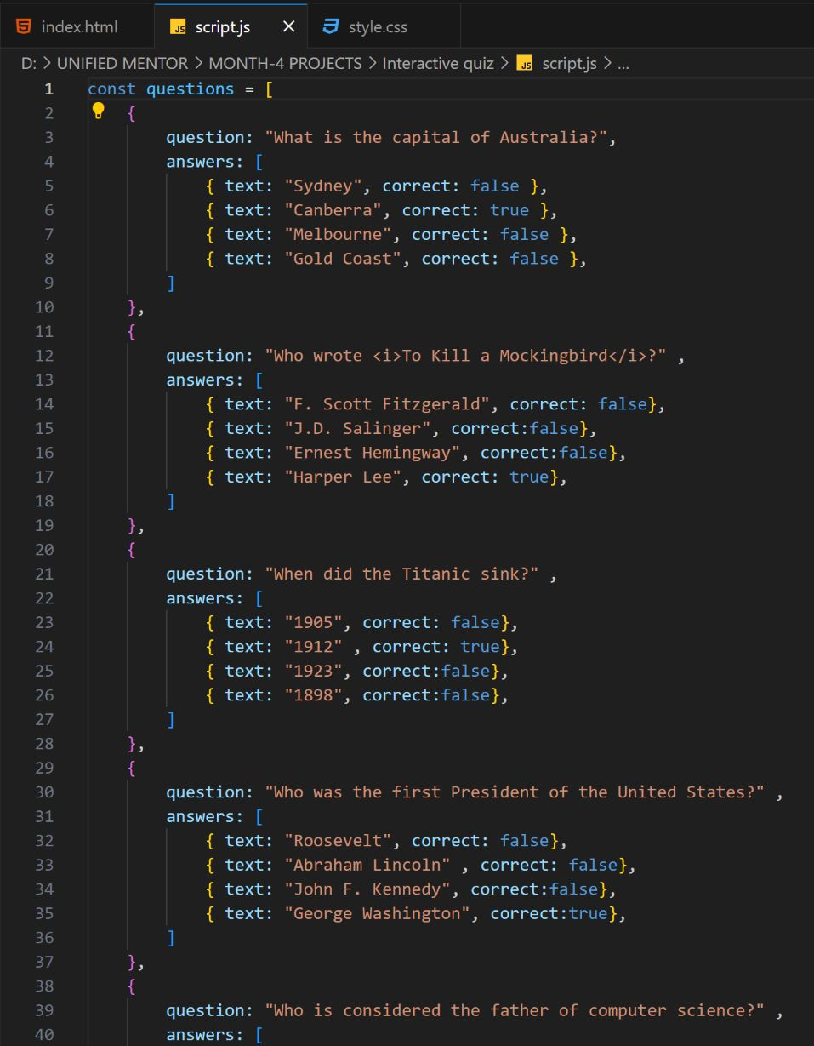
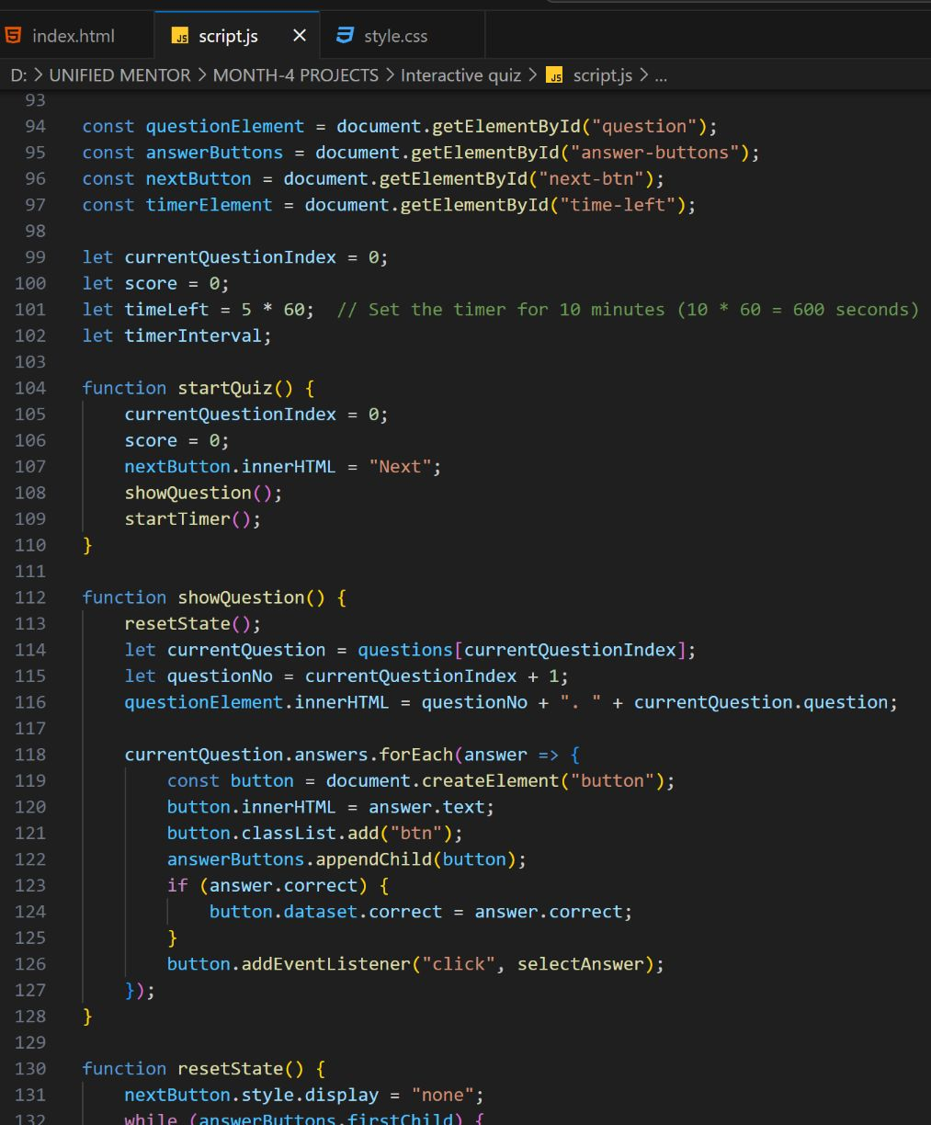
Javascript:
JavaScript (JS):Used to add interactivity, handle dynamic question rendering, track user answers, calculate scores, implement the countdown timer, and manage the quiz flow.

Slide 8
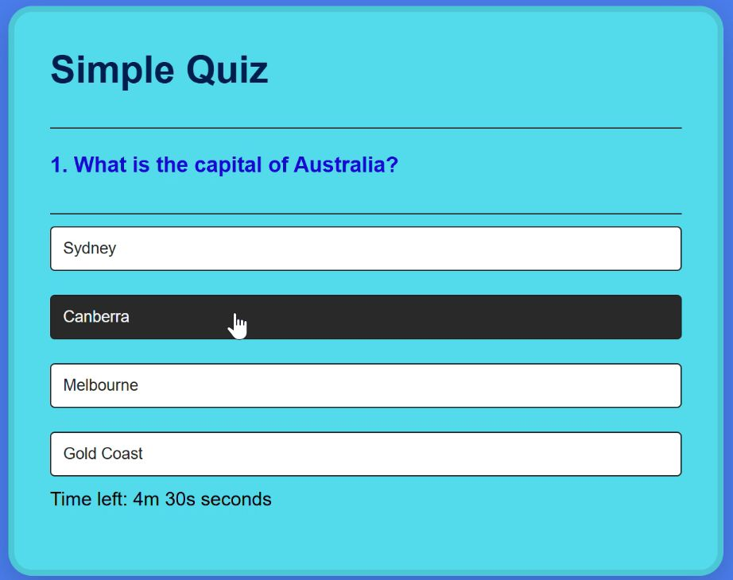
Interactive Quiz Video

Slide 9
Conclusion:
The Interactive Quiz Application successfully demonstrates how core web technologies—HTML, CSS, and JavaScript—can be combined to create an engaging and dynamic user experience. The project covers essential programming concepts such as DOM manipulation, event-driven programming, conditional logic, and styling principles.
This project serves as a foundational example for understanding the principles of front-end web development. It not only offers a functional quiz experience but also provides a platform to practice coding skills and explore advanced features in web development.

Slide 10
🚀 Future Enhancements
To make the application more robust, user-friendly, and feature-rich, the following improvements can be considered in future versions:
Add Categories or Topics:
Allow users to choose quiz categories like Science, History, Technology, etc.
Responsive Design Improvements:
Enhance mobile and tablet responsiveness for better accessibility.
Progress Bar:
Display a progress bar to visually indicate quiz completion status.
User Authentication:
Allow users to register and log in to save scores and track performance over time.
Leaderboard Feature:
Maintain a scoreboard for competitive quizzes with top user rankings.

Slide 11


Social Media Links:
https://comforting-sfogliatella-e4646c.netlify.app/
https://github.com/Mandadi2002/Unified-Mentor-FED/tree/main/Project-12%20Interactive%20Quiz

Slide 12
“The beautiful thing about learning is that nobody can take it away from you.” — B.B. King
THANK YOU!

